Slide 1
Customer Retention Data Analysis
By Aradhana Chatterjee

Slide 2
Problem Statement
Customer satisfaction has emerged as one of the most important factors that guarantee the success of online store; it has been posited as a key stimulant of purchase, repurchase intentions and customer loyalty. A comprehensive review of the literature, theories and models have been carried out to propose the models for customer activation and customer retention. Five major factors that contributed to the success of an e-commerce store have been identified as: service quality, system quality, information quality, trust and net benefit. The research furthermore investigated the factors that influence the online customers repeat purchase intention. The combination of both utilitarian value and hedonistic values are needed to affect the repeat purchase intention (loyalty) positively. The data is collected from the Indian online shoppers. Results indicate the e-retail success factors, which are very much critical for customer satisfaction.

Slide 3
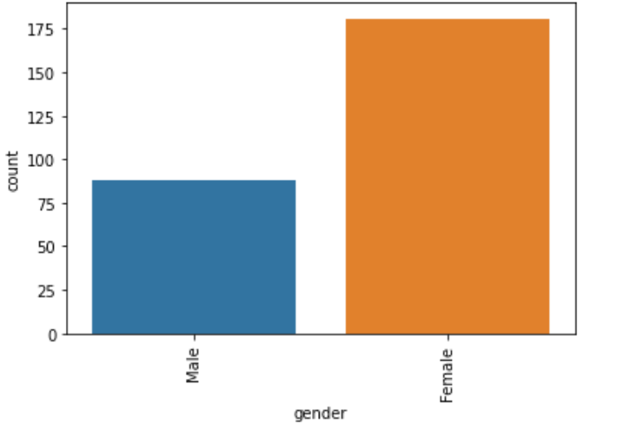
Customers categorized by gender
Around 88 people who took the survey are male and 181 are female.

Slide 4
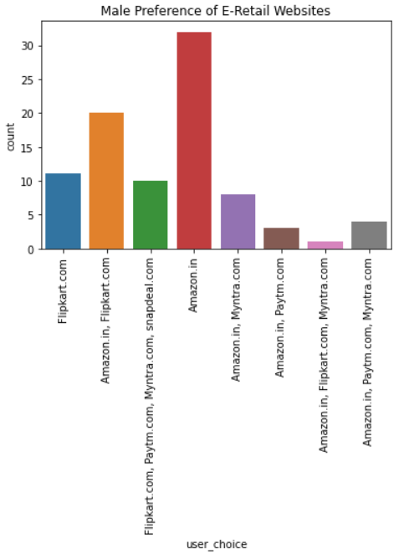
Male preference of e-retail websites
Most males preferred just Amazon.in, and Amazon.in and Flipkart.com.
Least males preferred Amazon.in + Flipkart.com + Myntra.com

Slide 5
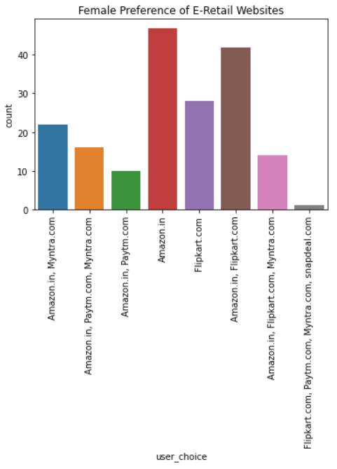
Female Preference of E-Retail Websites
Most females preferred Amazon.in and Amazon + Flipkart.
Least females preferred Flipkart+Paytm+Myntra+Snapdeal.

Slide 6
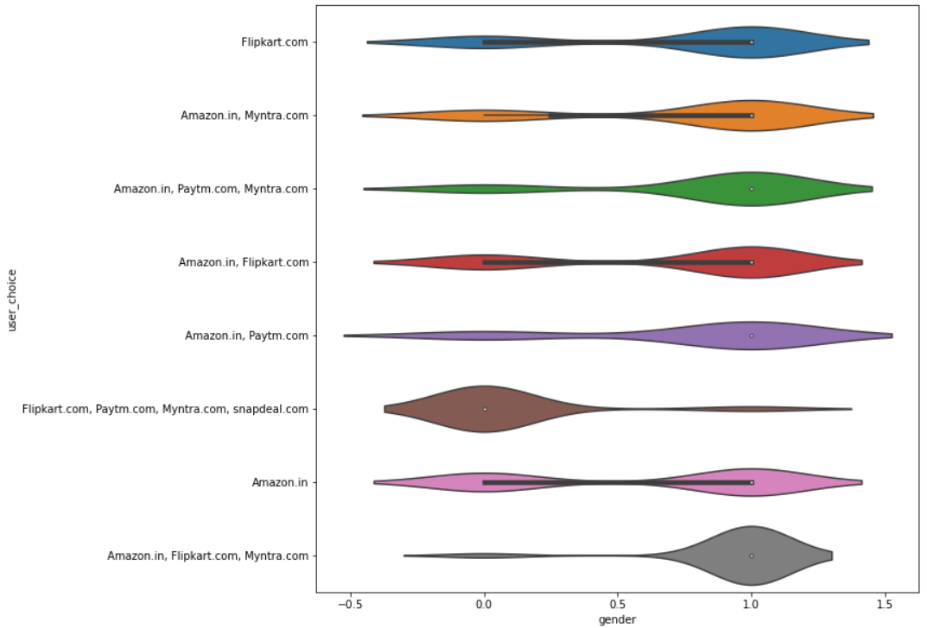
E-retail website preference by gender
Females preferred amazon+flipkart+myntra significantly more than males, whereas males preferred flipkart+paytm+myntra+snapdeal significantly more than females.
All the other distributions are more or less equivalent.

Slide 7
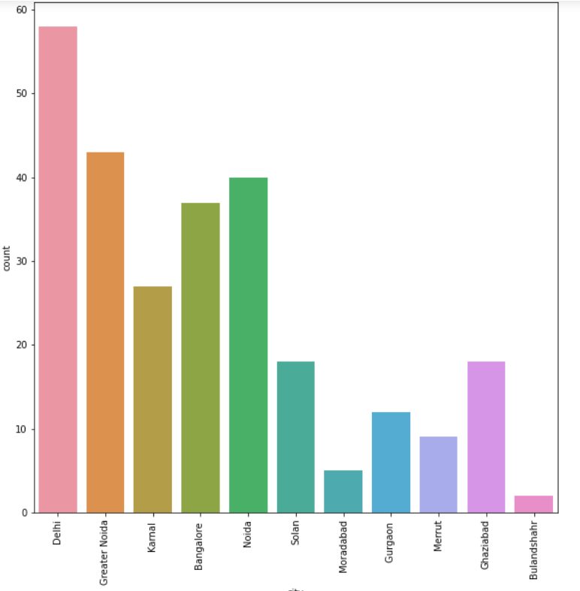
Cities of residence of customers
Most of the customers in this survey reside in the Delhi NCR region. Some customers are also from Bangalore. Least amount of customers from Bulandshahr.

Slide 8
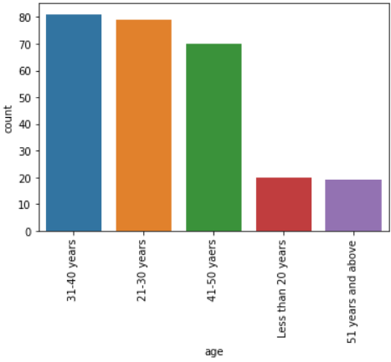
Age of Customers
Most customers are in the age groups 31-40 and 21-30. Least customers are in age groups less than 20 years and 51 years and above.

Slide 9
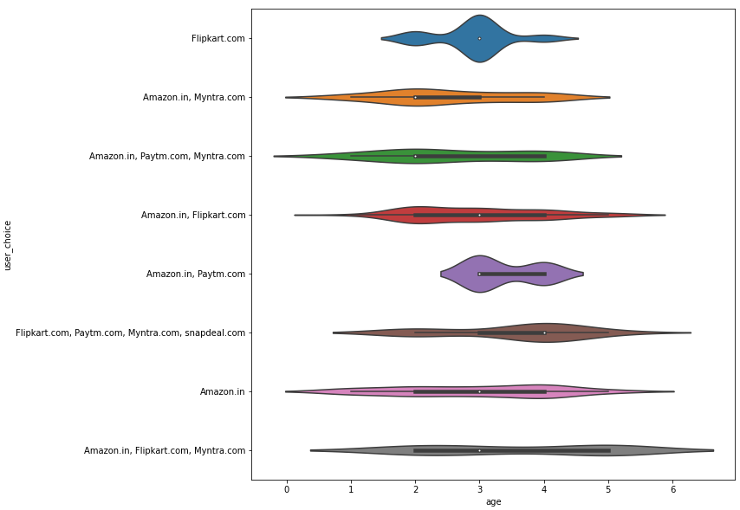
Website preference by age
People in younger age groups preferred Myntra more, and people in older age groups preferred Paytm and Snapdeal more. Amazon and Flipkart is preferred by all.

Slide 10
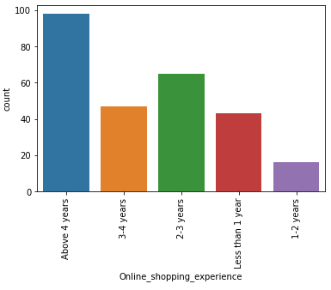
Online Shopping Experience
Most customers in this survey have online shopping experience of 4+ years and 2-3 years. Least of them have been shopping for 1-2 years.

Slide 11
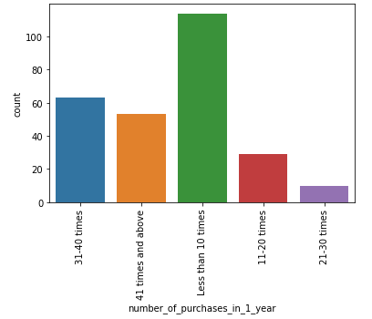
Number of online purchases in 1 year by the customers
Most customers ordered less than 1o times, or in contrast, 31-40 times. Least number of customers ordered 21-30 times.

Slide 12
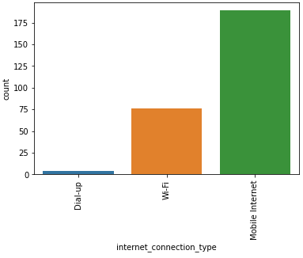
Type of Internet Connection used by customers
Most customers used mobile internet to access the e-retail websites. A moderate amount used Wi-Fi and least number of customers used dial-up.

Slide 13
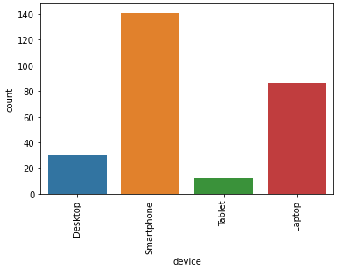
Type of device used by customers
Most customers used smartphone. Second majority of customers used laptop and 3rd majority used desktop. Least customers used tablet.

Slide 14
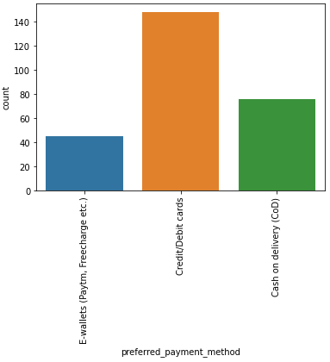
Preferred Payment Method of Customers
Most customers prefer to pay using Credit/Debit cards. Second majority prefer cash on delivery (COD), and least customers use E-Wallets.

Slide 15
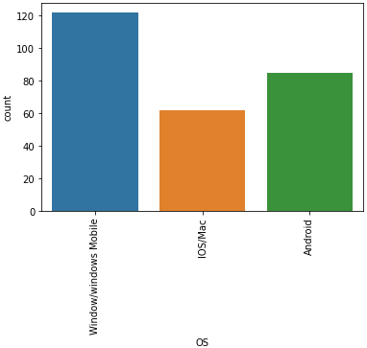
Operating System used by customers
Most customers used Windows or Windows phone. Second majority used Android, and least customers used IOS/Mac.

Slide 16
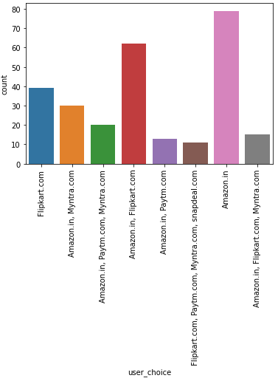
Websites customers would recommend to a friend
Majority of customers would recommend Amazon or Amazon and Flipkart. Least amount of customers would recommend Flipkart+Paytm+Myntra+Snapdeal.

